Slide 1
FP5
By: Devin Lee, Jason Yang, Jefferson Vang, Kolhby Xiong, Siab Vang

Slide 2
Test Case 1
Test Case ID: 1
Test Case Title: M created

Slide 3
Description
Method looks for first row that have “to be processed” as its execution status
If there is a row in the ms_test_data that have “to be processed” as its execution status, it will create variables for all columns in the database
It then will look into the database for the table Movies and create variables
It then detect if there is data based in the sql statement
If there is data on the sql statement, it will assign the moviestatement variable to “[2] Movie ignored”.
If there isn’t data, then it will insert into the movies table the movie and assign the moviestatement variable to “[1] Movie created”

Slide 4
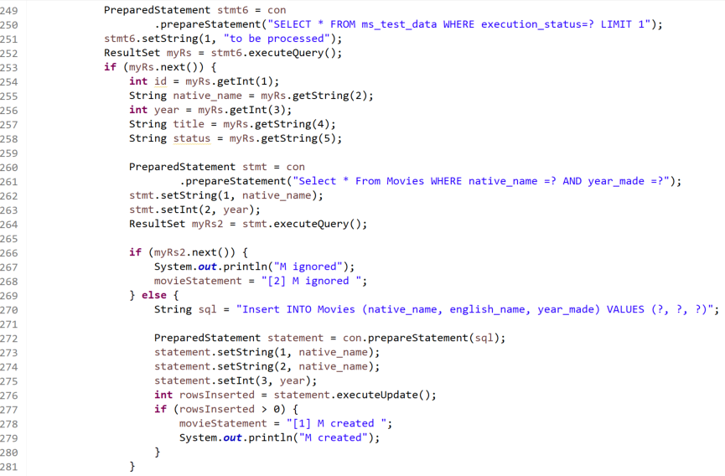
Data

Slide 5
Test Case 2
Test ID: 2
Test Case Title: [2] M ignored

Slide 6
Description
Method looks for first row that have “to be processed” as its execution status
If there is a row in the ms_test_data that have “to be processed” as its execution status, it will create variables for all columns in the database
It then will look into the database for the table Movies and create variables
If there is a movie that match the “native name” and “year made” for the rows in ms_test_data, it will be ignored and it will assigned the moviestatement variable as “[2] M ignored”.

Slide 7
Data

Slide 8
Test Cast 3
Test Case ID: 3
Test Case Title: [3] S created

Slide 9
Description
The sql statement that looks in the Songs table for a matching title from the title in the ms_test_data.
If there is no row, it will execute another sql statement that inserts into a row in the Songs table with the title from ms_test_data and other columns as none.
The moviestatement2 variable will be assigned to “[3] S created”.

Slide 10
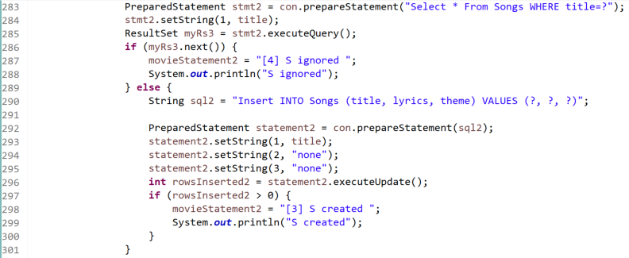
Data

Slide 11
Test Case 4
Test Case ID: 4
Test Case Title: S ignored

Slide 12
Description
The sql statement that looks in the Songs table for a matching title from the title in the ms_test_data.
If there exist a row, the moviestatement2 variable will be assigned to “[4] S ignored”.

Slide 13
Data

Slide 14
Test Case 5
Test Case ID: 5
Test Case Title: MS created

Slide 15
Description
The method checks if the native name of the ms_test_data existed in the Movies table.
If it do exist, it will create variables to that sql statement and the sql statement checks for the title of the row in ms_test_data that exist.
Next, the sql statement checks if the title in ms_test_data exists in the Songs table.
If there are rows for that sql statement, it will create variables as well.
Finally, the sql statement checks for the existence of the row in the Movie_song table and insert in the movie_song table.
If it is inserted into the Movie_song table, the moviestatement3 variable will be assigned to “[5] MS created”.

Slide 16
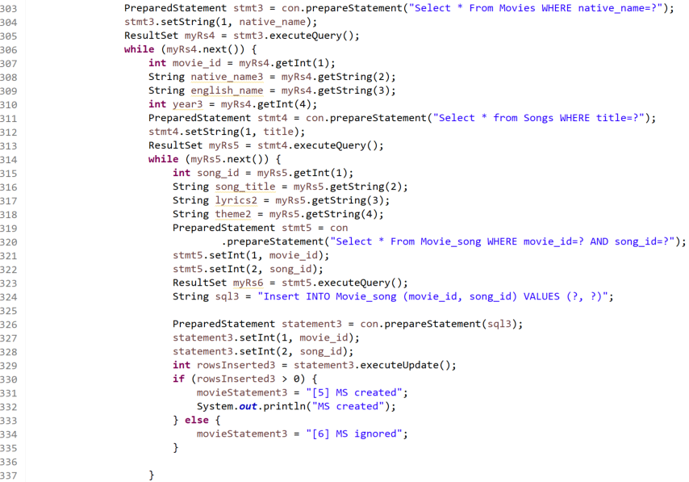
Data

Slide 17
Test Case 6
Test Case ID: 6
Test Case Title: [6] MS ignored

Slide 18
Description
The method checks if the native name of the ms_test_data exist in the Movies table.
If it does exist, it will create variables to that sql statement and the sql statement checks for the title of the row in ms_test_data that exist.
Next, the sql statement checks if the title in ms_test_data exist in the Songs table.
If there are rows for that sql statement, it will create variables as well.
Finally, the sql statement checks for the existence of the row in the Movie_song table.
If the sql statement isn’t inserted into the Movie_song table, the moviestatement3 variable will be assigned to “[6] MS ignored”.

Slide 19
Data

Slide 20
Test Case 7
Test Case ID: 7
Test Case Title: “[2] M ignored, [4] S ignored, [6] MS ignored”

Slide 21
Description
The sql statement will check in the ms_test_data table where execution status is “[1] M created [3] S created [5] MS created”
If there is an existence, the update sql statement will run and set the execution status to "[2] M ignored [4] S ignored [6] MS ignored"
Another sql statement will check in the ms_test_data table where execution status is "[2] M ignored [3] S created [5] MS created"
If there is an existence, the update sql statement will run and set the execution status to "[2] M ignored [4] S ignored [6] MS ignored"
In the bottom, there is another sql statement that updates the ms_test_data table execution status from “to be processed” to the three moviestatement variables combined.

Slide 22
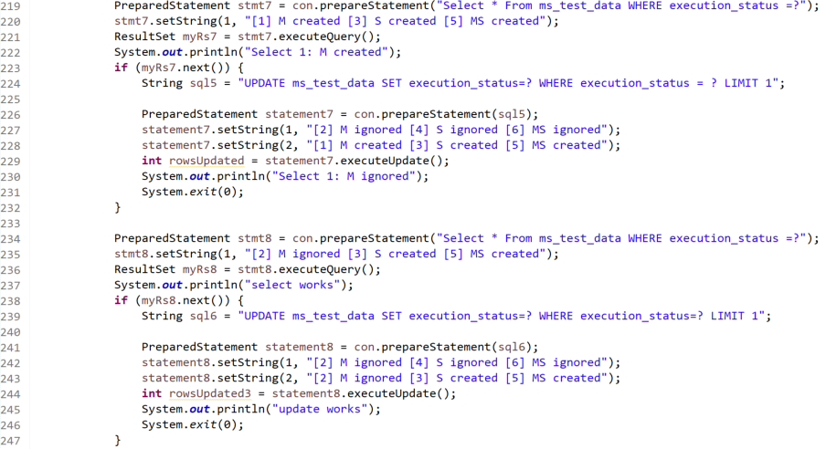
Data

Slide 23
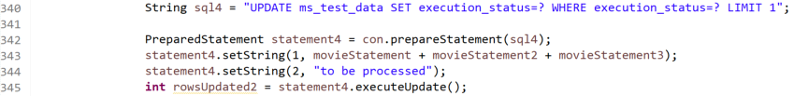
Data (Continued)

Slide 24
Expected Result For First Run
Execution status of the first row that has been inserted will be changed to “[1] M created [3] S created [5] MS created”
The movie “Frozen” is created in “Movies” table
The song “Frozen Heart” is created in “Songs” table

Slide 25
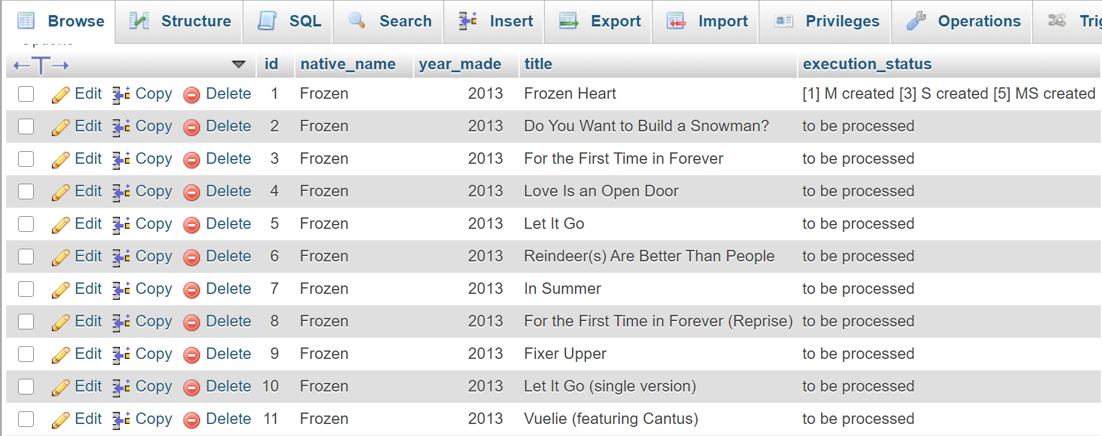
First Run Results:
Ms_test_data table

Slide 26
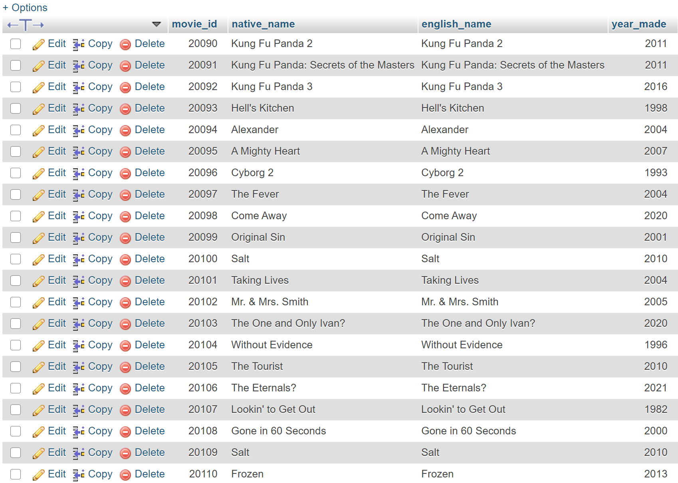
First Run Results:
Movies table

Slide 27
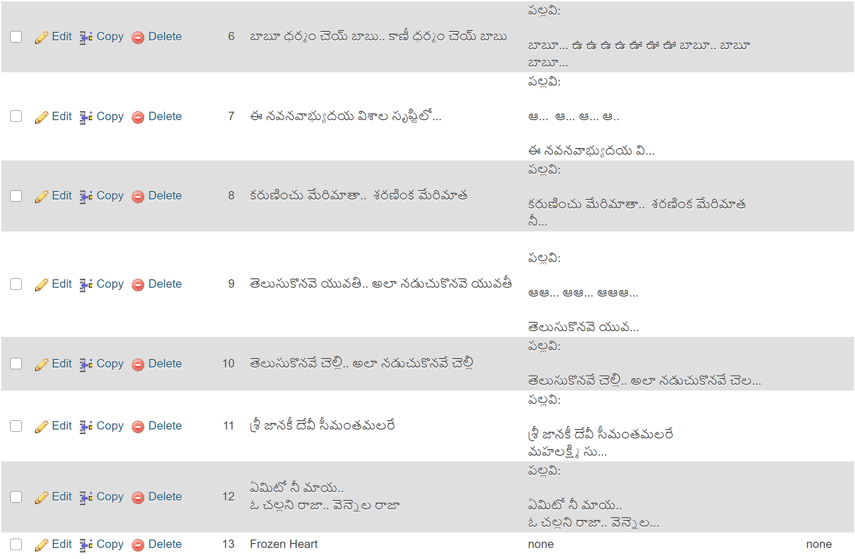
First Run Results:
Songs table

Slide 28
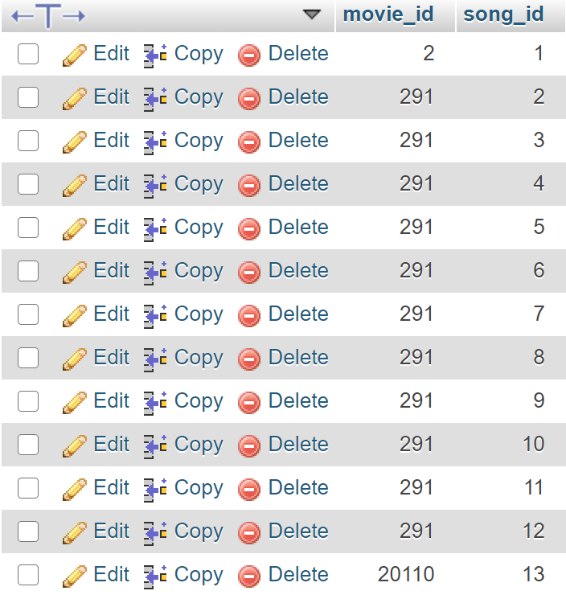
First Run Results:
Movie_song table

Slide 29
Expected Result for Second Run
Execution status of the first row that has “[1] M created [3] S created [5] MS created” will be changed to “[2] M ignored [4] S ignored [6] MS ignored”

Slide 30
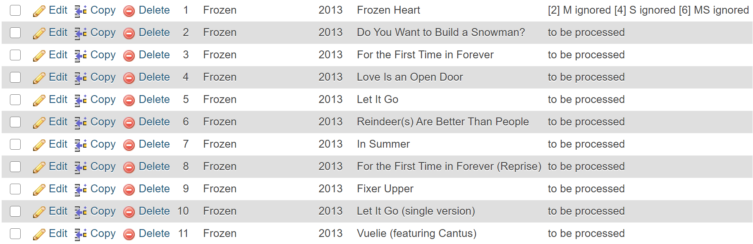
Second Run Results:
Ms_test_data

Slide 31
Expected Result for Third Run
Execution status of the ms_test_data table in second row will be changed from “to be processed” to “[2] M ignored [3] S created [5] MS created”
The song “Do you want to build a snowman” will be inserted into the song table.
Id of both Movie and Song will be inserted into the movie_song table.

Slide 32
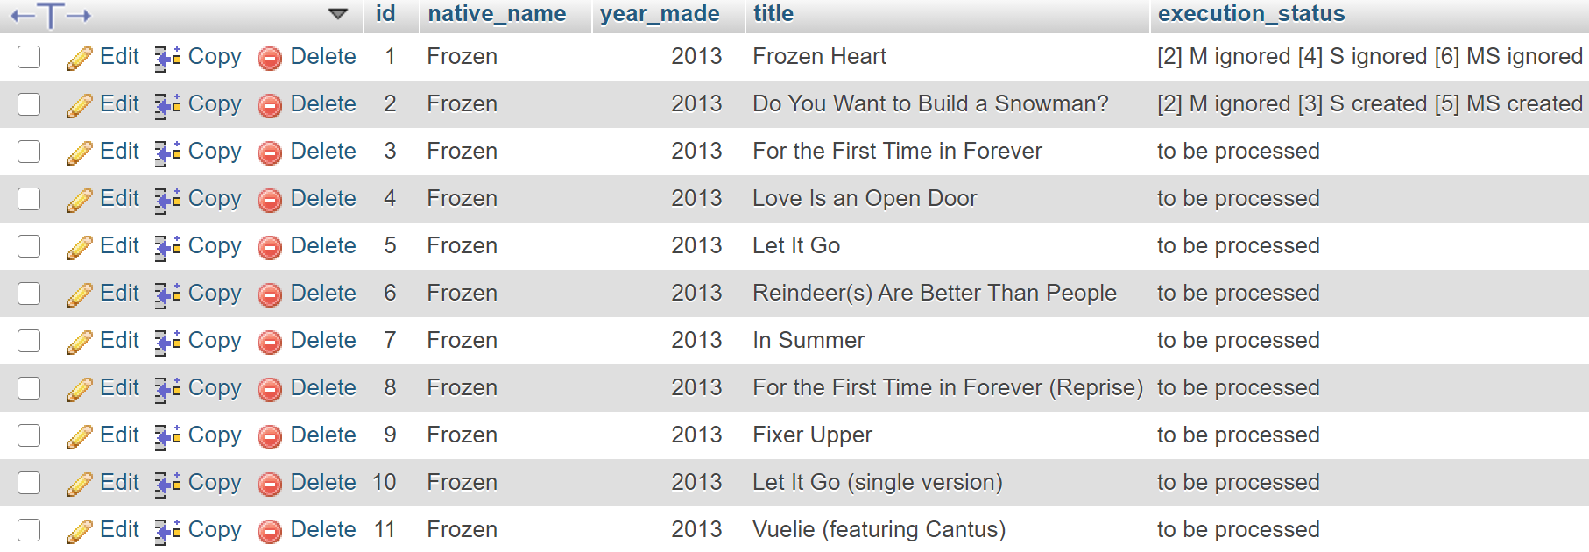
Third Run Results:
Ms_test_data

Slide 33
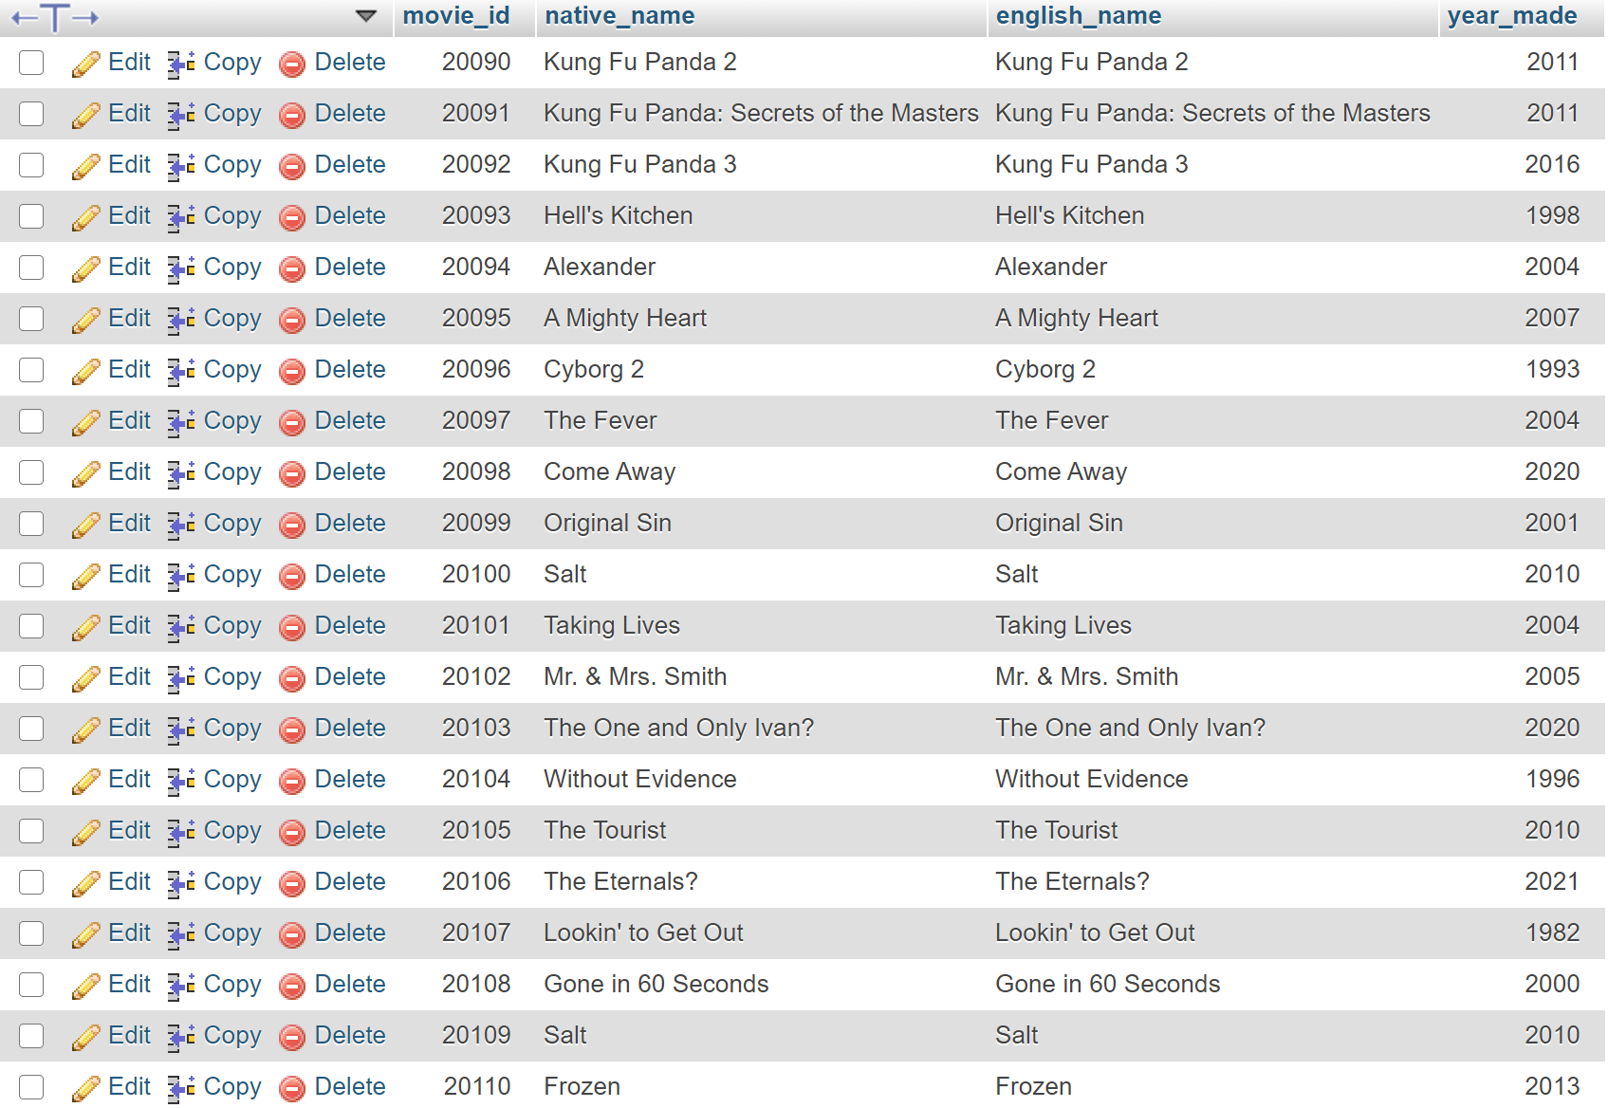
Third Run Results:
Movies table

Slide 34
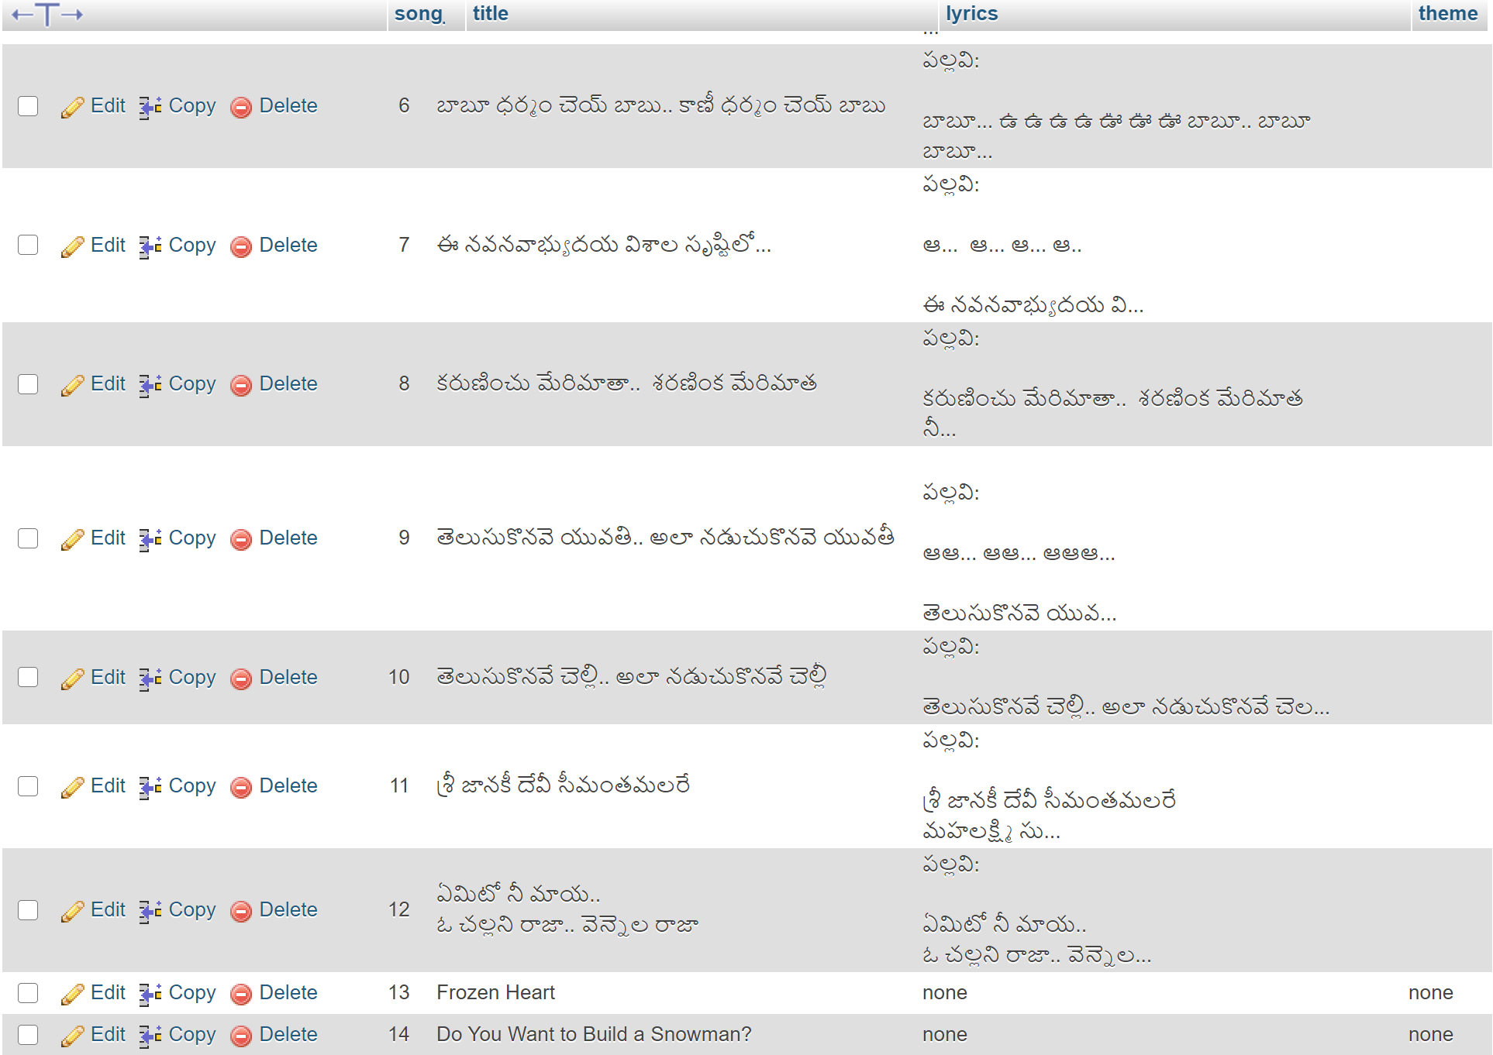
Third Run Results:
Songs table

Slide 35
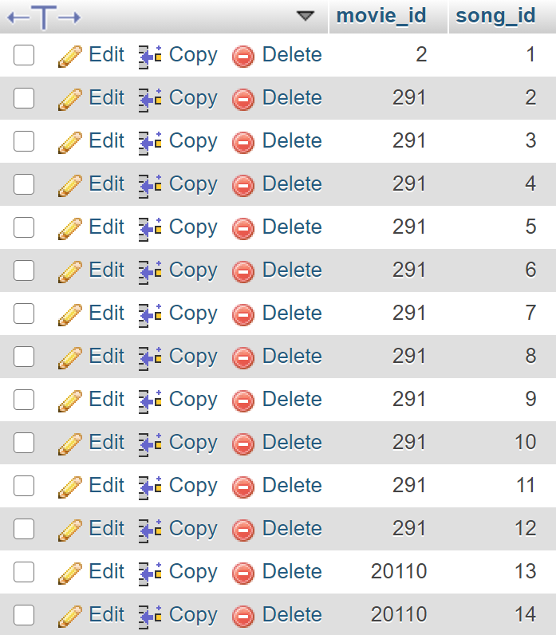
Third Run Results:
Movie_song table

Slide 36
Expected Result After Multiple Run to Check for West Side Story
Execution status for all Frozen rows will be “[2] M ignored [4] S ignored [6] MS ignored”
When first song in West Side Story is next, the execution status will be changed to “[1] M created [3] S created [5] MS created”
There will be an insertion of the West Side Story data in the movie table
There will be an insertion of the row in ms_test_data table, songs table, and movie_song table.

Slide 37
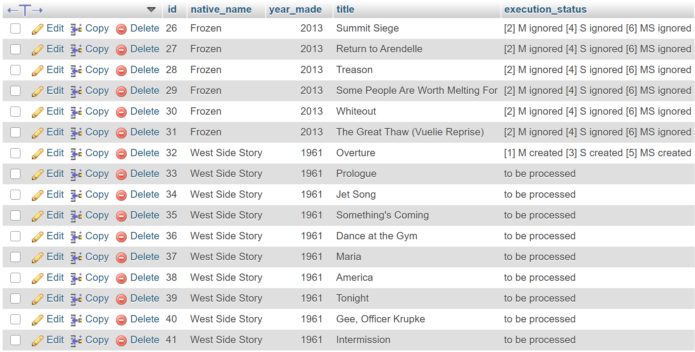
Result for West Side Story:
Ms_test_data table

Slide 38
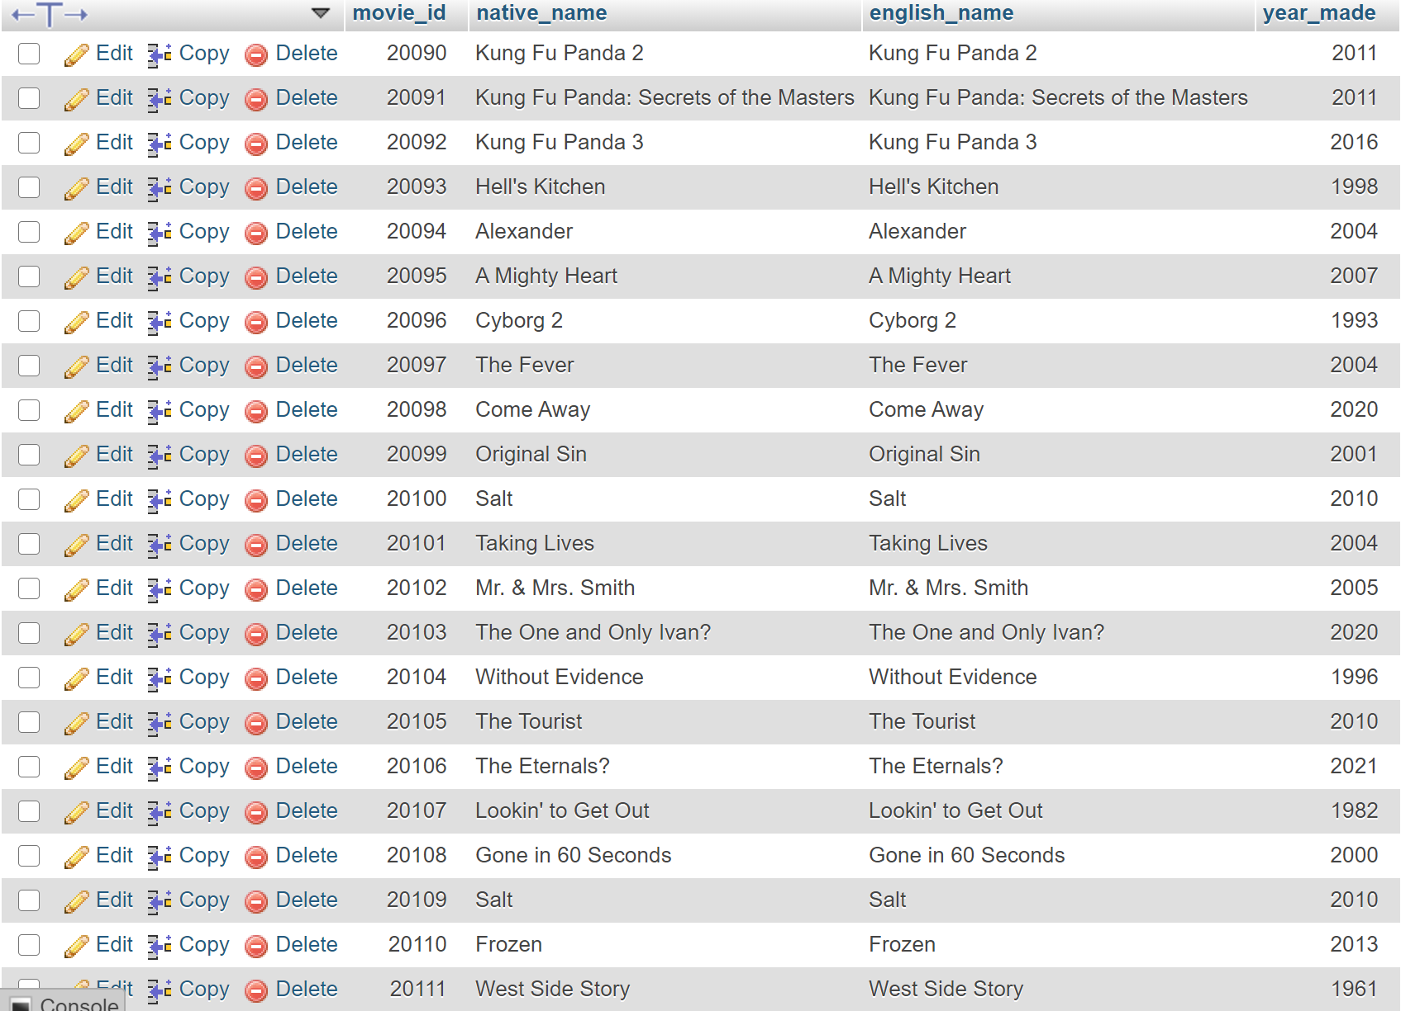
Result for West Side Story:
Movie table

Slide 39
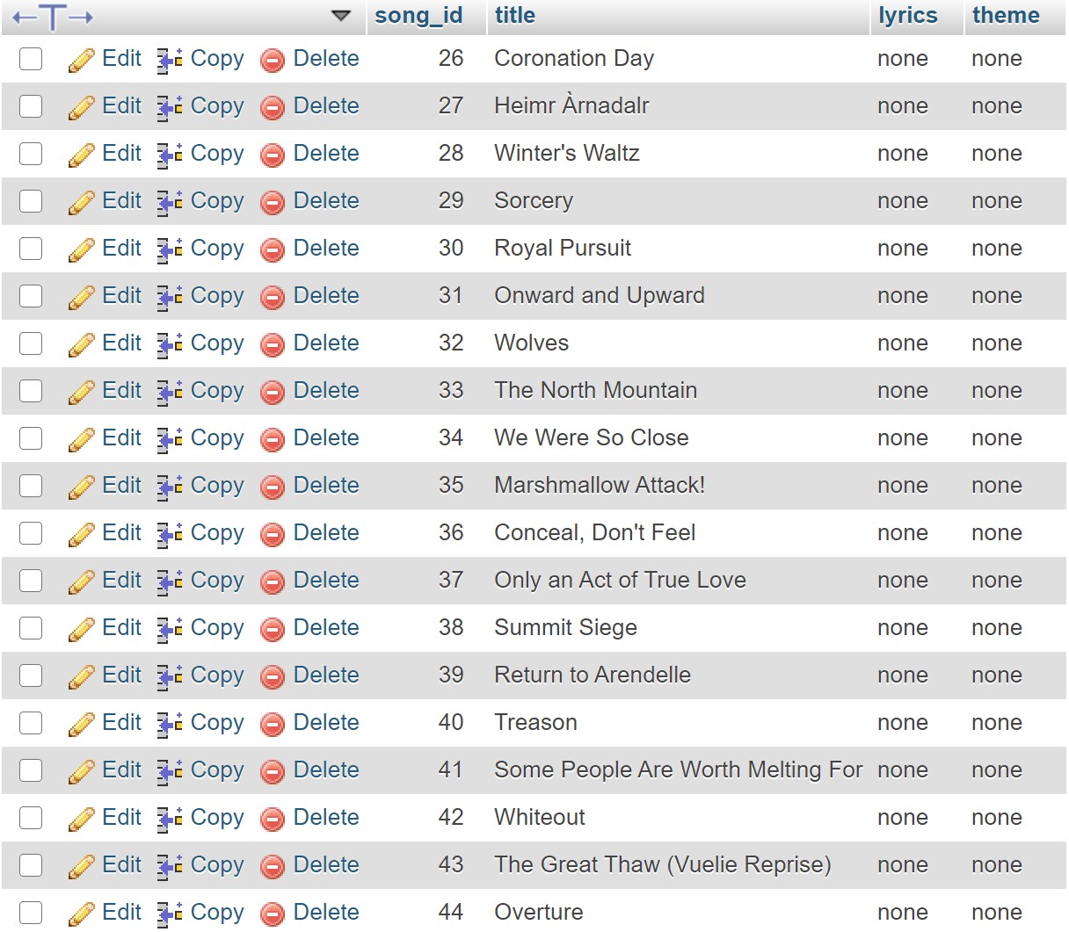
Result for West Side Story
Song table

Slide 40
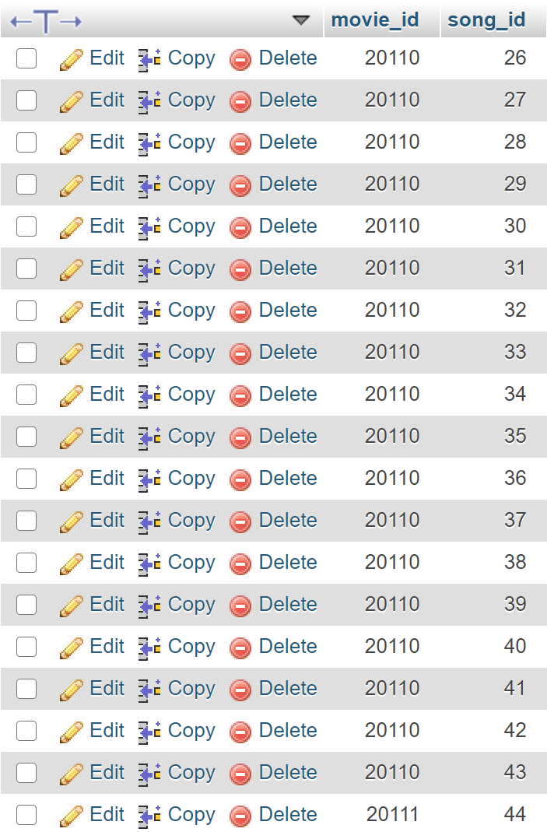
Result for West Side Story:
Moive_song table

Slide 41
Expected Result for Another Final Run for West Side Story
The execution_status for the first West Side Story row will read “[1] M ignored [3] S ignored [5] MS ignored

Slide 42
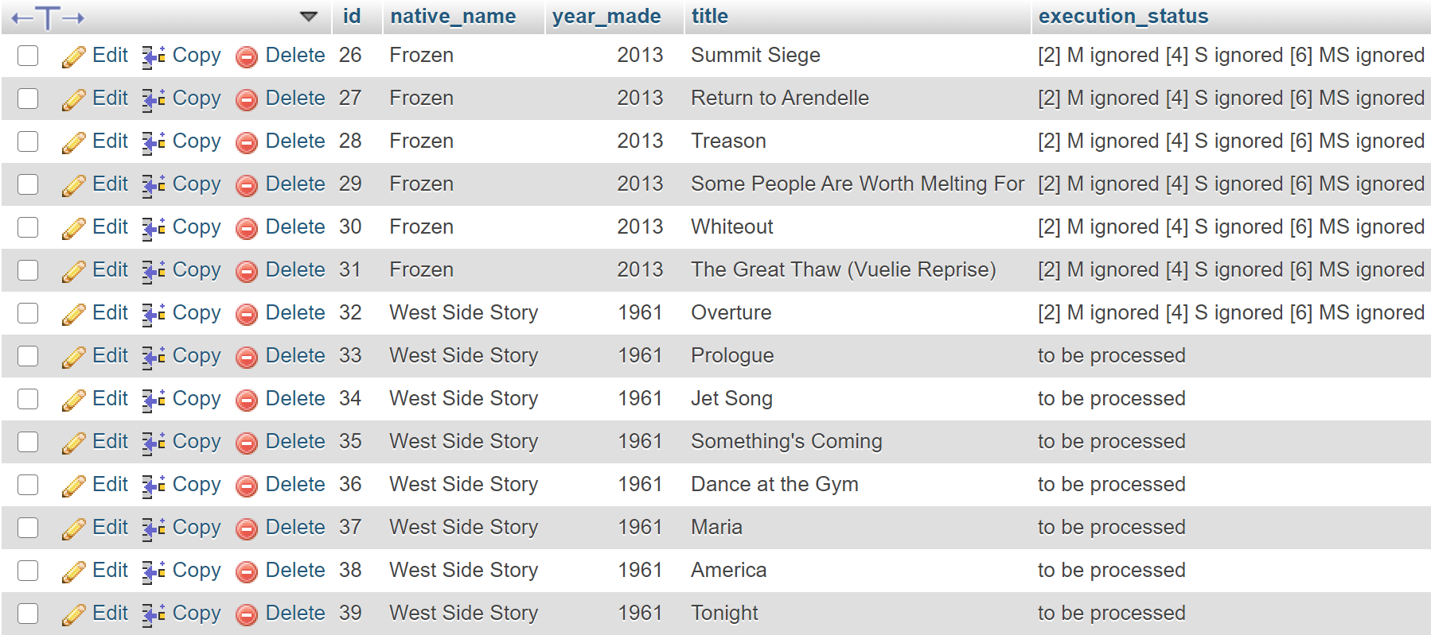
Result for West Side Story After First Run:
ms_test_data

Slide 43
Conclusions and Thoughts
We believed that we had successfully coded FP4 to what it has required.
We also had to refactor the code and format it as well.
We included the run for West Side Story because there were a need to check for errors and to check if the processmoviesong method only detect one movie instead of multiple movies.
We had deleted the database and recreated the database lots of times, so we learned to export the database into a sql file to easily create the database and test the code a multiple of times.
It took a lot of trials and errors to successfully finalize the code to what it is.

Slide 44
End

